Slide 1
JAVASCRIPT HOISTING

Slide 2
JavaScript Hoisting
Hoisting is a mechanism in JavaScript that moves the declaration of variables and functions at the top
In JavaScript we can use variables and functions before declaring them.
JavaScript hoisting is applicable only for declaration not initialization
It is required to initialize the variables and functions before using their values

Slide 3
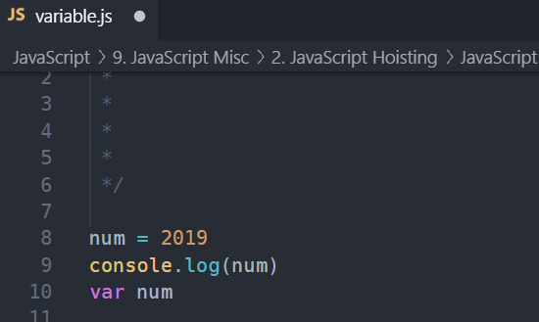
JavaScript Variable Hoisting

Slide 4
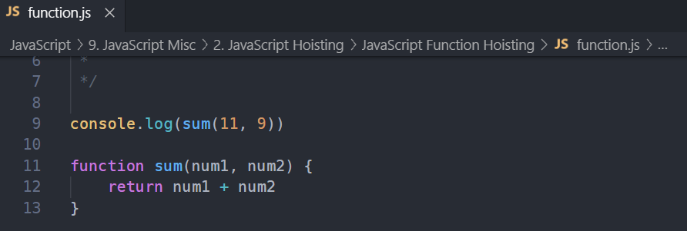
JavaScript Function Hoisting

